Slide 1
SonarQube rule checkers and alternatives, Pre-Commit Functionality
November 2020

Slide 2
Introduction
SonarQube is a platform developed by SonarSource for continuous inspection of code quality and static code analysis
It performs automatic reviews with static analysis of code to detect bugs, code smells, and security vulnerabilities on 20+ programming languages
SonarQube offers
reports on duplicated code
coding standards
unit tests
code coverage
code complexity
comments
bugs
security vulnerabilities

Slide 3
SonarQube Editions and License
The Community edition of SonarQube is distributed under free and open source license
The Developers, Enterprise and Data Canter editions are commercial versions of the software
Some important features belong to the commercial edition such as C MISRA 12 check is available with the Developers commercial edition.
The open source Community version provides the static code analysis for 15 languages (C/C++ not included)
Java, JavaScript, C#, TypeScript, Kotlin, Ruby, Go, Scala, Flex, Python, PHP, HTML, CSS, XML and VB.NET

Slide 4
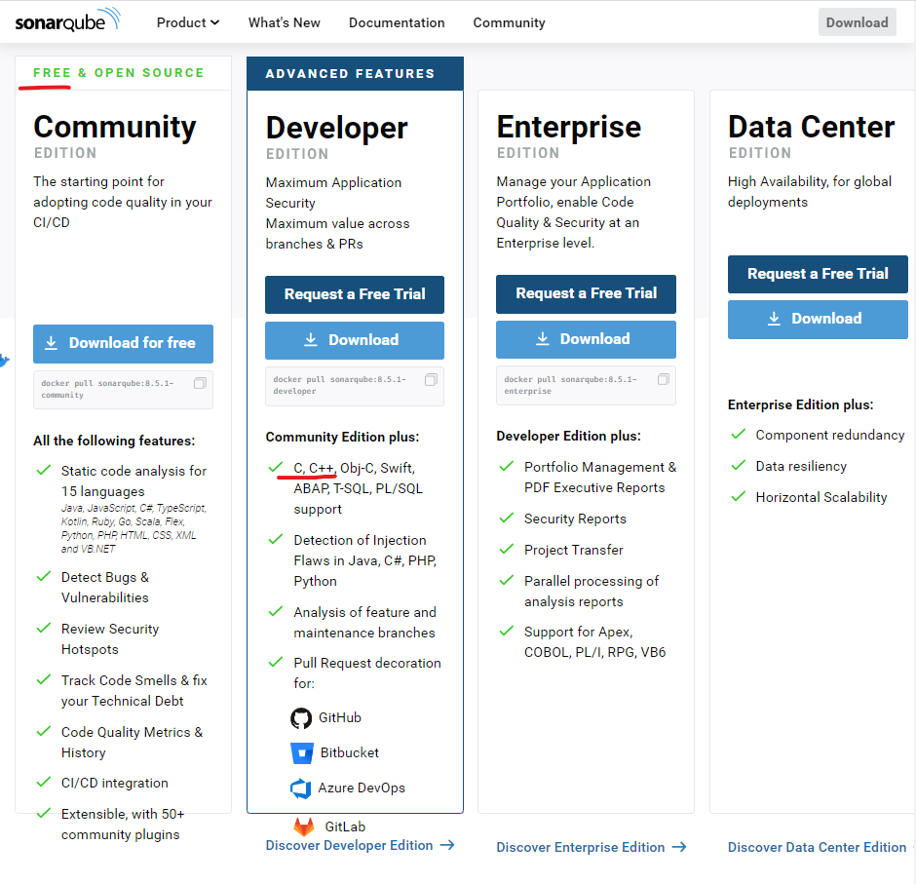
SonarQube Editions and License

Slide 5
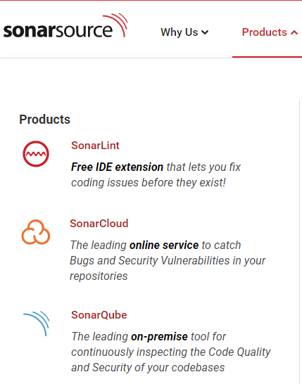
SonarCloud
The same checker engine is shared with SonarCloud
Is free for open source projects
private organizations have to pay it
24 languages (including C)
Code review is run on sonar servers
Meant to be integrated with cloud solutions (e.g., github)
https://community.sonarsource.com/t/sonarcloud-vs-sonarqube/9557/2

Slide 6
MISRA Support
SonarQube supports partially
MISRA C 2004
MISRA C++ 2008
MISRA C 2012
Very limited MISRA C support
The rules implemented for can be found at: https://rules.sonarsource.com/cpp/tag/misra-c2004/ 5 https://rules.sonarsource.com/cpp/tag/misra-c++2008/ 7 https://rules.sonarsource.com/cpp/tag/misra-c2012/ 16

Slide 7
SonarQube Web Site - Supported Rules

Slide 8
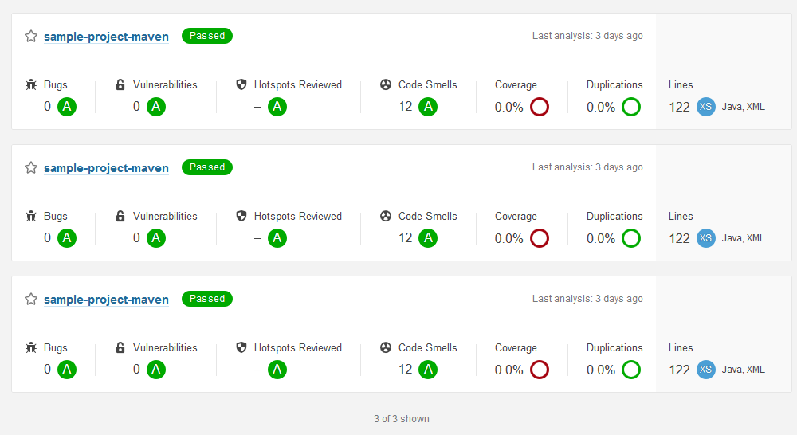
Running SonarQube
SonarQube is a web service able to provide information regarding the executed code analysis of projects. The service can be called by command line (both for Windows and Linux).

Slide 9
SonarQube Service
Using the Graphical User Interface (GUI) provided by the web service, it is possible to configure specific analyses
However the GUI does not allow the user to directly execute the analysis itself.
For starting a new analysis, SonarQube provides the command line to be executed in the terminal (for Linux) or in the command prompt (for Windows).
After having executed the command, SonarQube will show the result of the analysis through the GUI accessible with the web browser.

Slide 10
The SonarScanner tool
The SonarQube platform provides the ability to trigger the analysis and the related report generation, by means of the SonarScanner tool.
Developers can see whether there are violations in the their new code
SonarScanner takes in input the project to be analysed and produces a report that SonarQube can display through the web browser
The SonarScanner should be executed through command line with related input parameters or, alternatively, input parameters can be included in a configuration file that the scanner loads each time it is executed
Every time the scanner is executed on the same project, it updates the list of violations available in SonarQube

Slide 11
Pre-Commit Functionality Implementation
Pre-Commit allows the developer to automatically check the quality of the code before it is committed
TortoiseSVN lets setting the so-called pre-commit hook. It is a program (or a script) that is run when the user clicks on the button “OK” in “SVN Commit” window.
The hook checks the content of modified files and block commit when deemed appropriate.
It is important to note that Tortoise executes the hooks locally before committing, without leaving a trace of the operation on the repository server
Pre-Commit can be implemented in several ways, expecially depending on how the result of the code check is produced (e.g. inserting tags in the code or producing a report)
In case of code tagging, the hook will check tags in the code and allow the commit operation only if no violation tags are found
In case of report, the hook will analyse the report and will allow the commit only if it does not report violations

Slide 12
Pre-Commit Client-Side Implementation
Implementation of the Pre-Commit functionality using SonarQube and TortoiseSNV can be performed on the local machine exploiting the SonarQube web service providing the report of the performed analysis
One solution can be the following (this is not the only way):
Configure TortoiseSVN for pre-commit setting a hook
The hook is implemented ad-hoc for:
triggering the code analysis by means of SonarScanner;
retrieving automatically from the SonarQube service the report of the last code analysis;
searching for violations in the report and returning a response to Tortoise.
Block the commit operation if the response of the hook reports the presence of rule violations
Similar client-side solutions can be also applied to Git repository

Slide 13
Pre-Commit Server-Side Implementation
Server-side hooks reside in server-side repositories an they are provided by both SVN and Git
Git provides the so called pre-receive hooks that allow the user to implement the a sever-side pre-commit.
The pre-receive hook is executed every time somebody uses git “push” command to push commits to the repository. It should always reside in the remote repository that is the destination of the push, not in the originating repository.
Like the client-side hook, it can be used for checking the code examining the SonarQube checking report
SVN provides a similar mechanism by means of server side hook scrips
A hook script is a program triggered by some repository event, such as the creation of a new revision or the modification of an unversioned property. Each hook is handed enough information to tell what that event is, what target(s) it's operating on, and the username of the person who triggered the event
These hook scripts are executed by the server that hosts the repository

Slide 14
Suppressing a Rule
SonarQube allows the developer to specify if for a specific line of code, warnings have to be suppressed using the //NOSONAR comment.
SonarQube will almost completely ignore issues on any line that ends with //NOSONAR. A justification can be added by the programmer following this comment.
There are several reasons to suppress warnings that otherwise are reported as violations.
For example, sometimes there are cases in which a rule must be violated. For instance, there are libraries whose methods throw exceptions

Slide 15
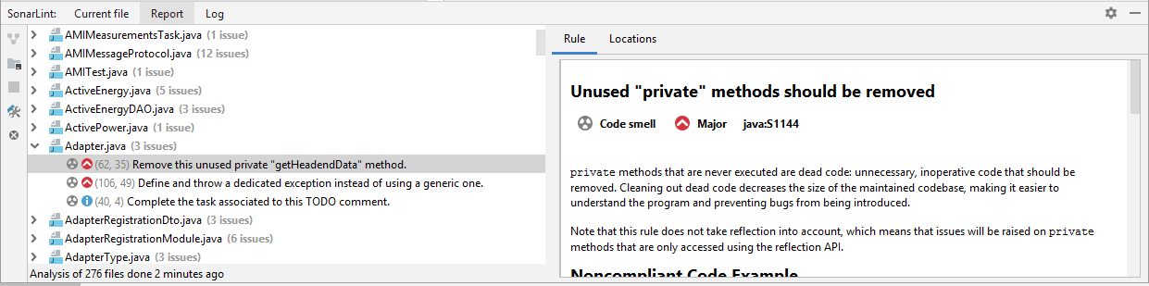
The SonarLint IDE Plugin
SonarSource povided the SonarLint IDE extension that helps to detect and fix quality issues in the code
Like a spell checker, SonarLint squiggles flaws so that they can be fixed before committing code. This plugin is available for: Eclipse, IntelliJ, Visual Studio, VS code. SonarLint is able to analyse the code while the developer is writing it and block the commit activity if some violation is detected
The following image refers to the SonarLint plugin for IntelliJ

Slide 16
Is SonarQube suitable?
Main issue:
Only 9 rules of MISRA C 2012 supported
What to do?
extend SonarQube checker (maybe not applicable)
search for alternatives supporting server-side pre-commit checks
In the following slides, some alternatives:
Support to pre-commit checks needs to be investigated

Slide 17
Alternatives to SonarQube 1/2
The following Table lists a set of free tools for C/C++ code checking. Most of them are able to perform MISRA rules checking but only a few of them, such as CppCheck, allows the developer to do this for free. Actually, even if these tools are classified as free, they claim a separate fee for enabling features including the MISRA checking rules ability.
Tool | Latest release | Description | License | Link | MISRA Checking | MISRA Check Language | Additional payment | Note
CodeCheck | 15.0 | CodeCheck is a programmable tool for checking all C and C++ source code on a file or project basis. CodeCheck is input compatible with all variants of Standard K&R C, Standard ANSI-C/C++, and all C and C++ compiler vendors. We support GCC-GNU Open Source C/C++ compilers. | Free (not found the specific type) | https://www.abxsoft.com/misra/misra-index.html | MISRA 2004 MISRA 1998 | C / C++ | NO
BLAST | 2.7.2 | An open-source software model checker for C programs based on lazy abstraction (follow-on project is CPAchecker). | Apache License, Version 2.0 | https://forge.ispras.ru/projects/blast | Not Supported | N.A. | N.A. | N.A.
Clang | 10.0.0 | An open-source compiler that includes a static analyzer. | UIUC (BSD-style) | https://clang.llvm.org/ | MISRA 2008 | C / C++ | NO | https://github.com/rettichschnidi/clang-misracpp2008
Coccinelle | 1.0.7 | An open-source source code pattern matching and transformation. | GPLv2 | https://coccinelle.gitlabpages.inria.fr/website/ | YES Not found the MISRA version supported and supported subset | C | NO | Adaptation of coccinelle to MISRA started on 2014 https://www.sciencedirect.com/science/article/pii/S0167642312002031

Slide 18
Alternatives to SonarQube 2/2
Tool | Latest release | Description | License | Link | MISRA Checking | MISRA Check Language | Additional payment | Note
Cppcheck | 2.2 | Open-source tool that checks for several types of errors, including use of STL. | GNU General Public License | http://cppcheck.sourceforge.net/ | MISRA C 2012 (partial) | C / C++ | YES, MISRA are suppoerted with the Commercial "Developers" version | Implemented rules: http://cppcheck.sourceforge.net/misra.php
cpplint |  | An open-source tool that checks for compliance with Google's style guide for C++ coding. | BSD license | https://google.github.io/styleguide/ | Not Supported | N.A. | N.A. | N.A.
Frama-C | 0.0.9 | An open-source extensible analysis framework for C with several analyzers and a specification language common to all of them. Includes analyses based on abstract interpretation, deductive verification and runtime monitoring. | BSD licenses | http://frama-c.com/ | YES Not found the MISRA version supported and supported subset | C | NO
Infer | 1.0.0 | Developed by an engineering team at Facebook with open-source contributors. Targets null pointer and other memory problems. | GPL | https://fbinfer.com/ | Not Supported | N.A. | N.A. | N.A.
Sparse | 0.6.3 | An open-source tool designed to find faults in the Linux kernel. | MIT License | https://sparse.docs.kernel.org/en/latest/ | Not Supported | N.A. | N.A. | N.A.
Splint | 3.1.2 | An open-source tool statically checking C programs for security vulnerabilities and coding mistakes. | GPL | https://sparse.docs.kernel.org/en/latest/ | YES Not found the MISRA version supported and supported subset | C / C++ | NO | https://www.exida.com/Blog/misra-compliance-static-analysis-results-iso26262-iec61508

Slide 19

Thank You!
Questions and Answers

